Slide 1
Simulating NV decay profiles from a noisy spin bath
Simulated spin bath dynamics to calculate Ramsey and Echo decays in 2 dimensions
Simulations are of the effective field at the NV
No unitary dynamics of the bath (b/c simulating a large bath); only simulating random occupations (based on a given density) and random flip flops (flip-flop rate determined by dipolar coupling between bath spins)
Slides 3-8 calculate coherence from the noise spectrum and filter function, only valid for either short times (easy to check) or gaussian noise (not true in the low-density cases).
Slide 18 shows an example of calculating the coherence without this assumption, by calculating <cos(phi)> after averaging over runs.
May do single NVs or ensembles (currently only in 2D)

Slide 2
Main ideas in the simulations
Randomly populate a 2D lattice with “bath” spins
Evolve the system in discrete time steps, inducing random flip-flops between bath spins at each time step (so total magnetization is conserved). No flip-flops with the central spin (by energy conservation). Flip flop rate determined by dipolar couplings.
Calculate B at the central spin at each time step, giving B(t)
Calculate and fit the spectral density |S(ω)|² from B(t)
Calculate and fit the Ramsey and Echo decays from |S(ω)|² and their respective filter functions (slides 3-8)
Note: This should only work for a) small times (so that <cos(φ)> ~ <1- φ²/2> ~exp(-< φ²>/2)) or b) gaussian noise, in which case the last expression is exact
Working on a more complete code that uses the moments of φ to calculate the decay, without invoking the above assumptions
Slide 18: calculate a phase accumulation for a given pulse sequence → calculate cos(phi) → run many times to obtain <cos(phi)>

Slide 3
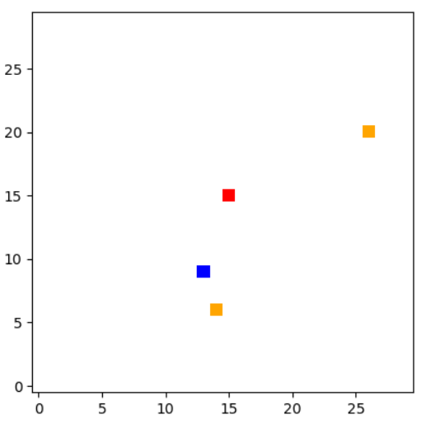
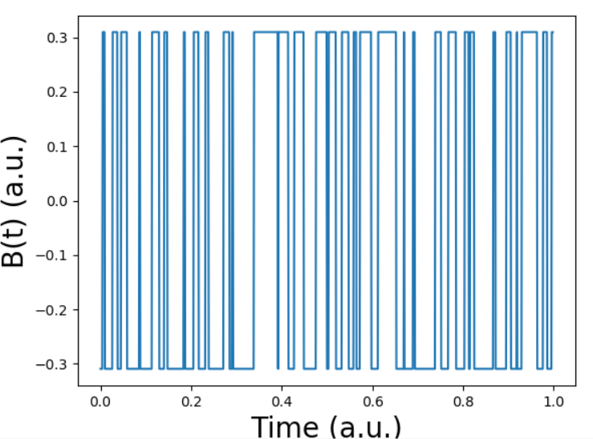
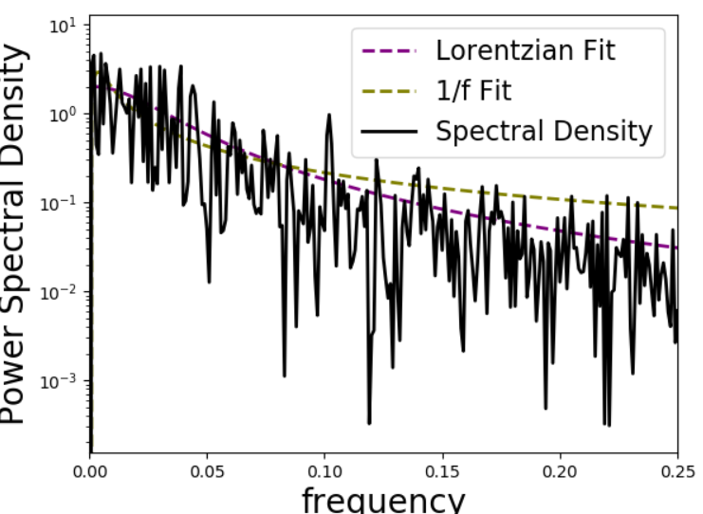
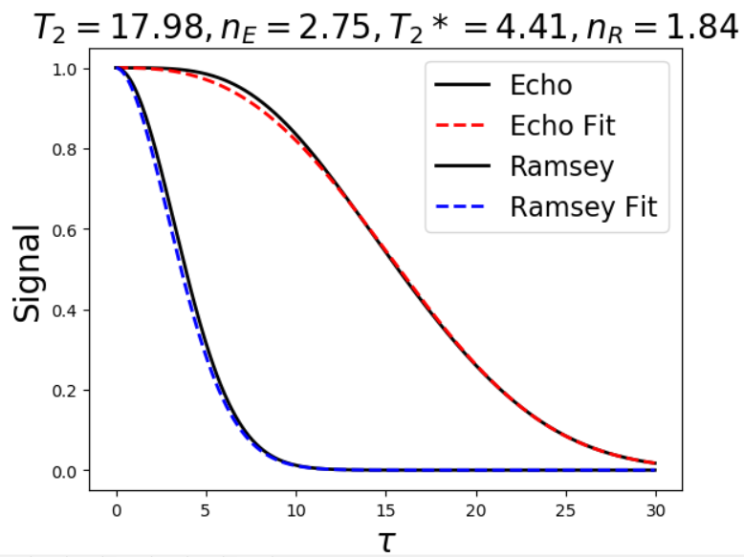
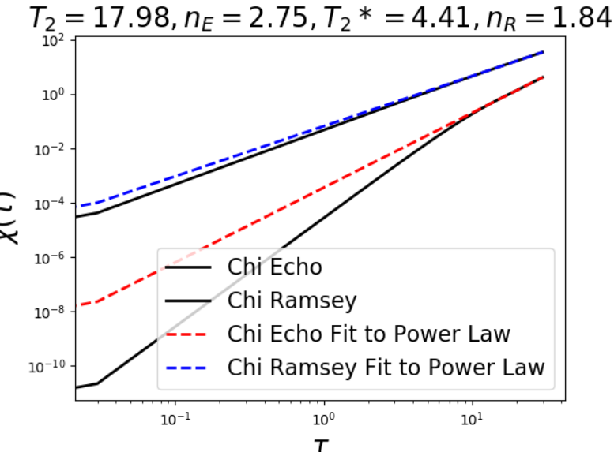
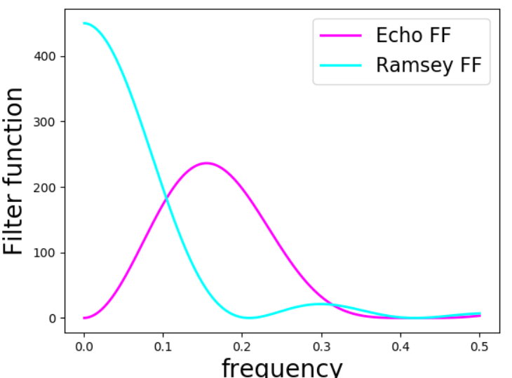
Occupation Probability = 0.005 sample dataset
NV
Spin up
Spin down

Slide 4
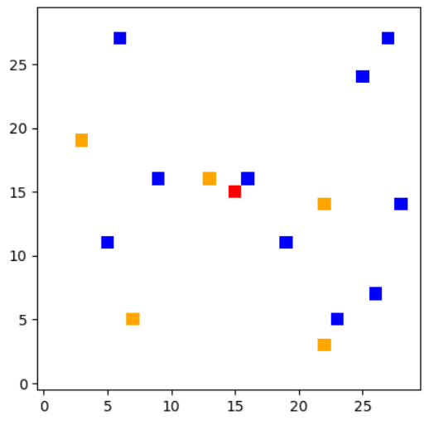
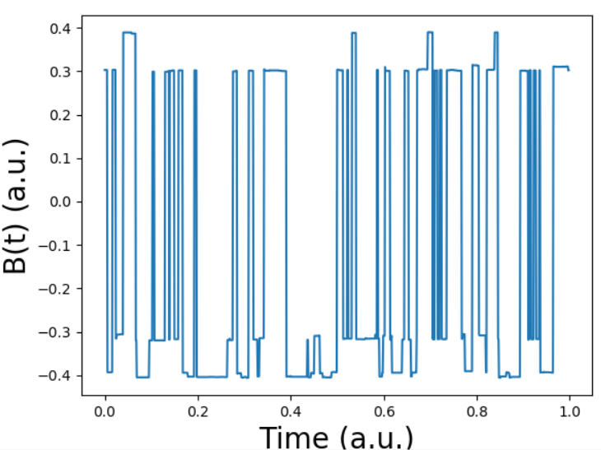
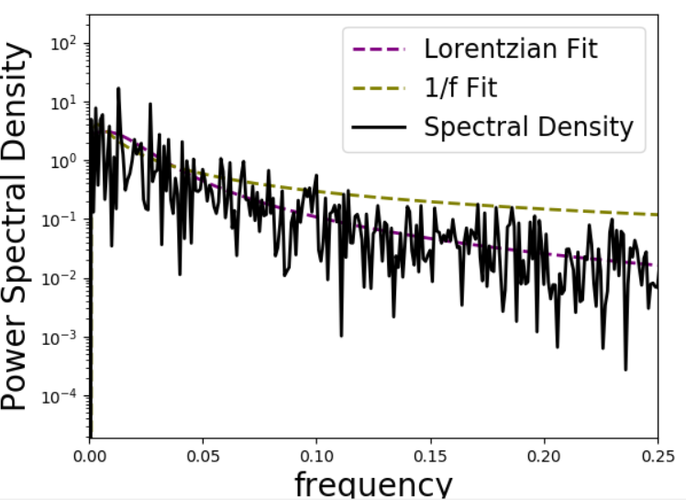
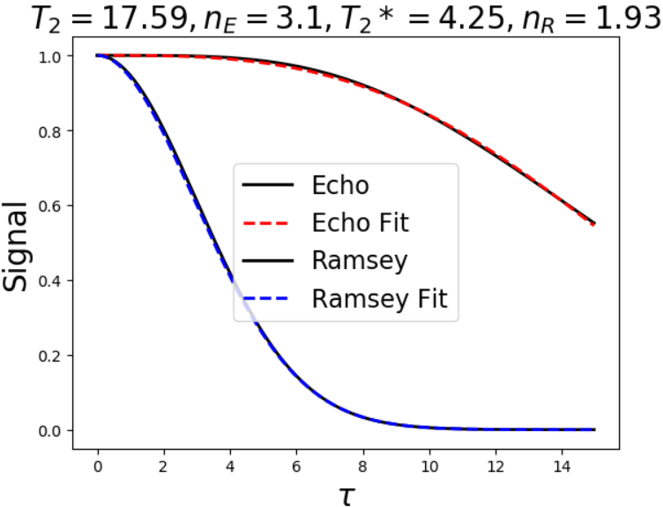
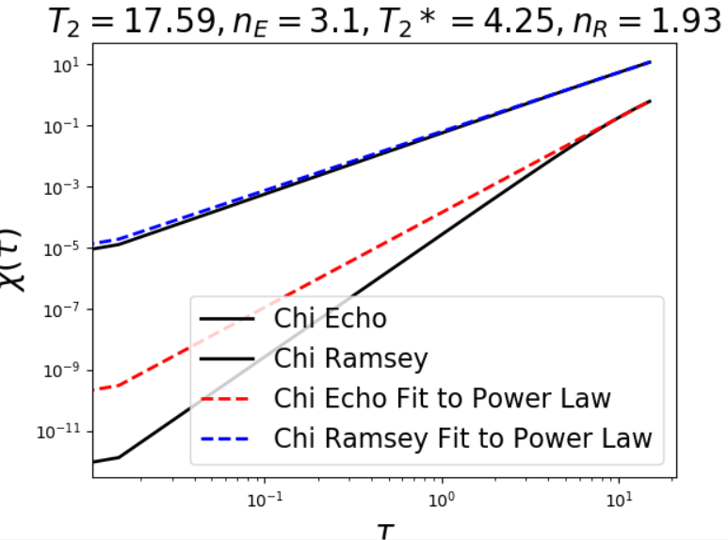
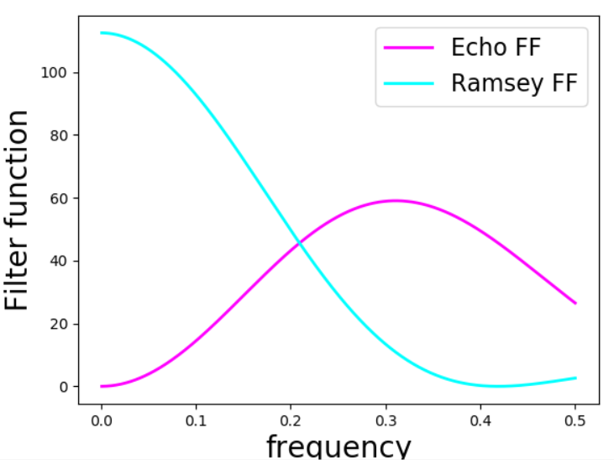
Occupation Probability = 0.02 sample dataset
NV
Spin up
Spin down

Slide 5
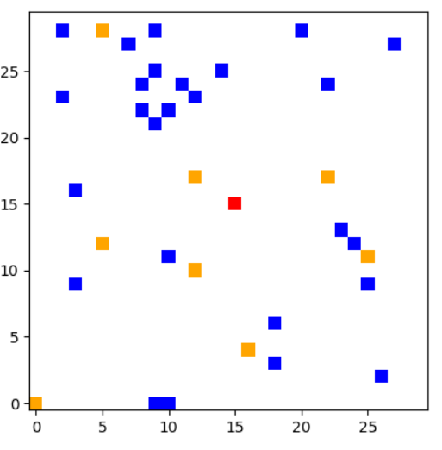
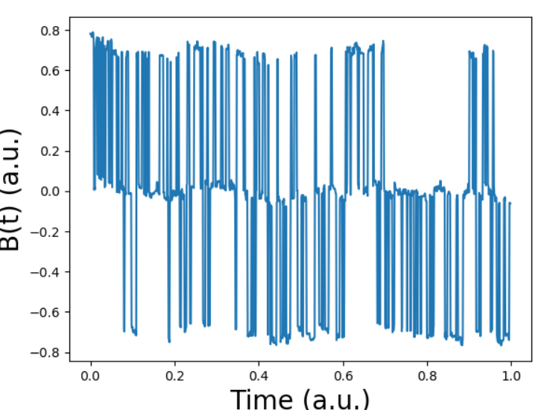
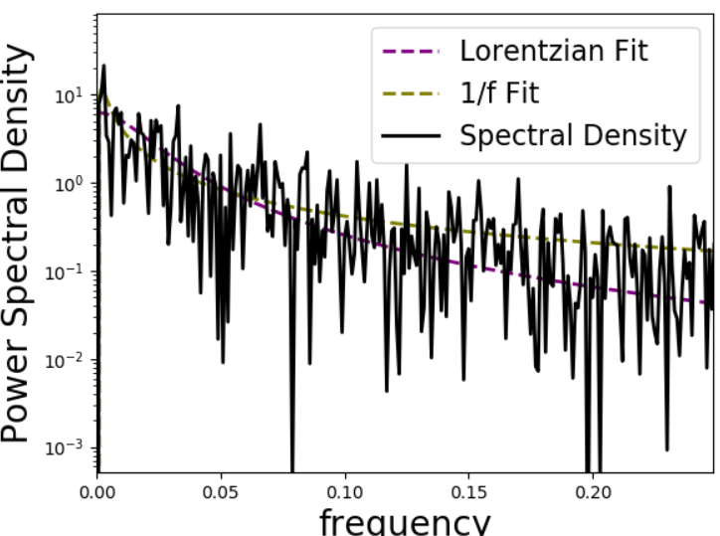
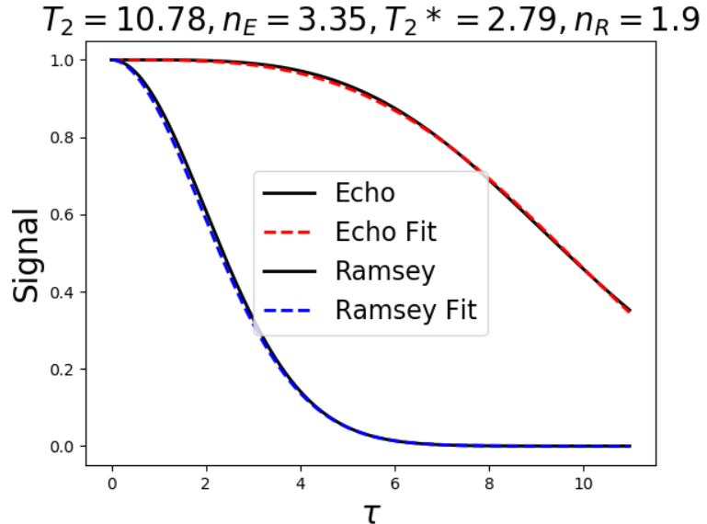
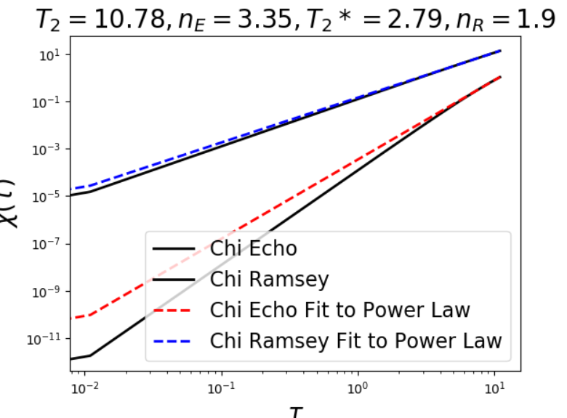
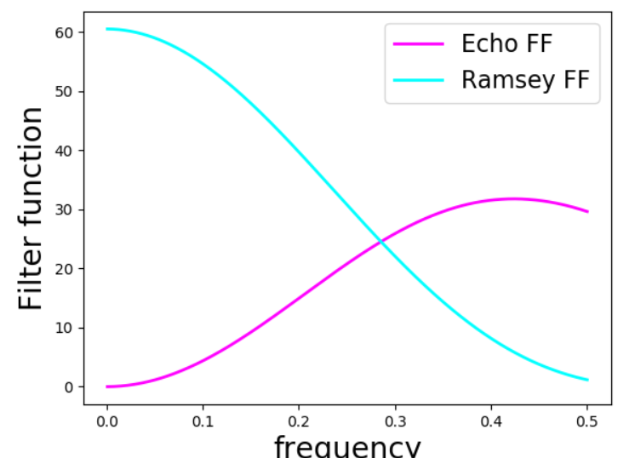
Occupation Probability = 0.035 sample dataset
NV
Spin up
Spin down

Slide 6
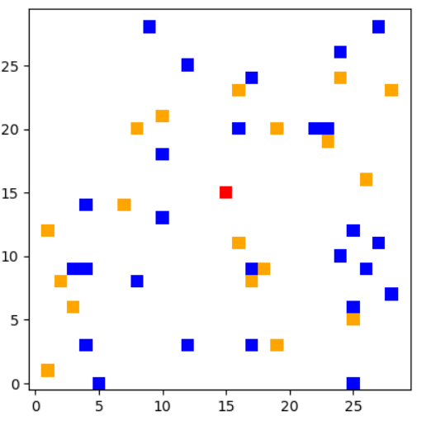
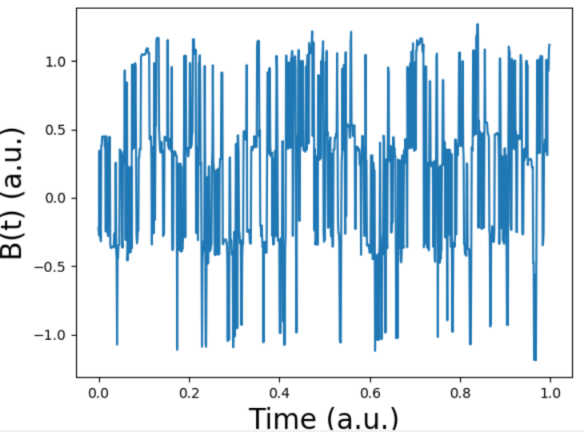
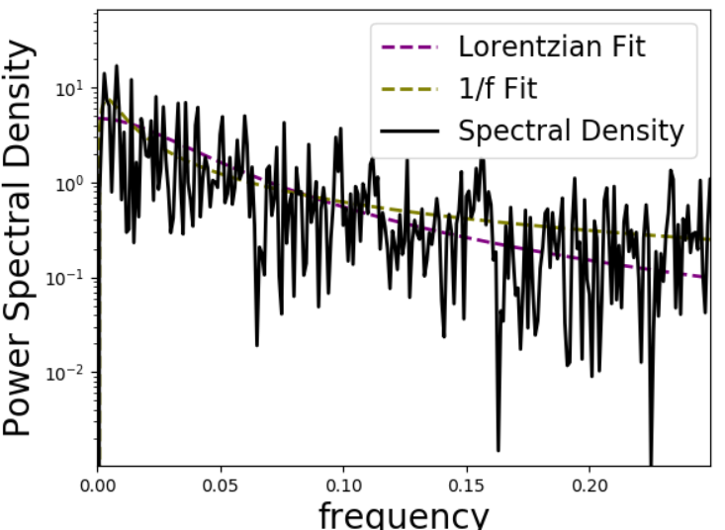
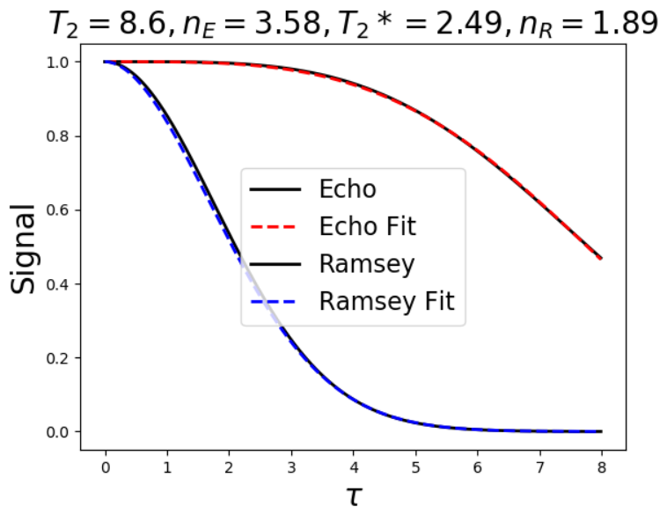
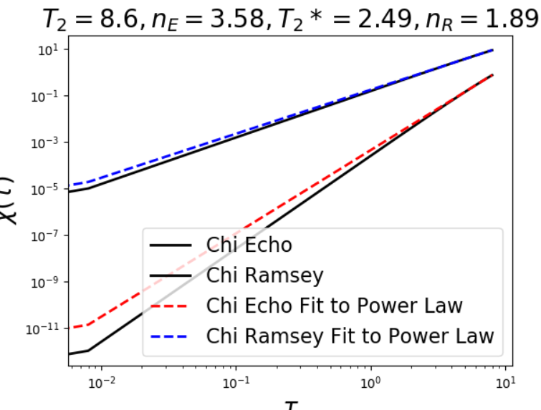
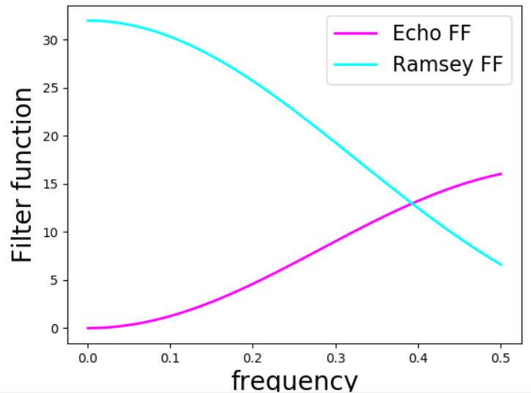
Occupation Probability = 0.05 sample dataset
NV
Spin up
Spin down

Slide 7
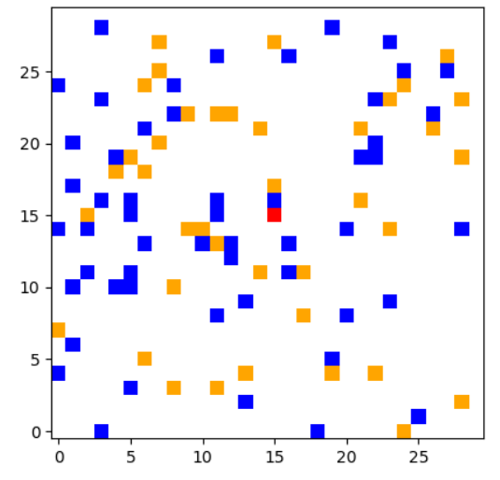
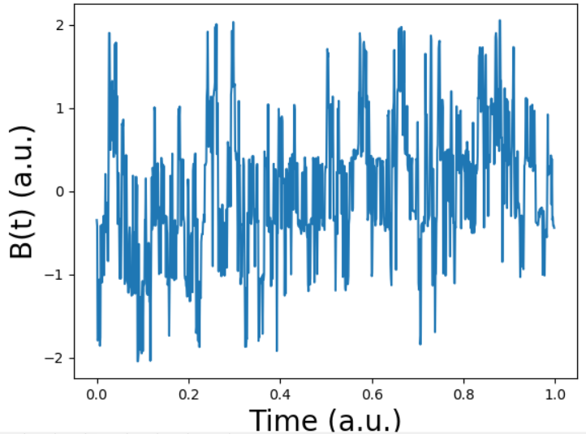
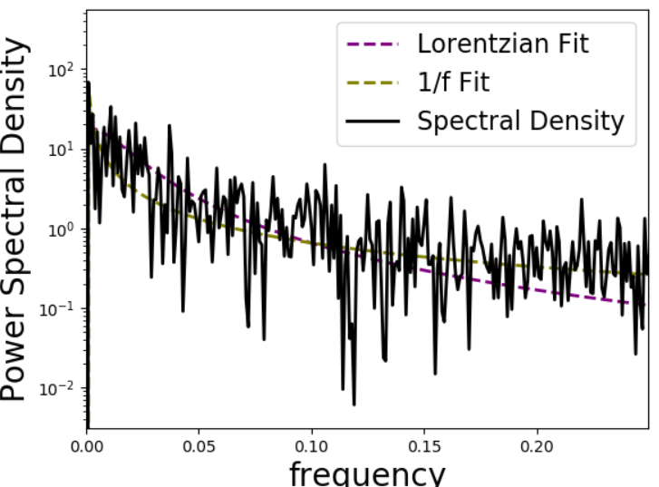
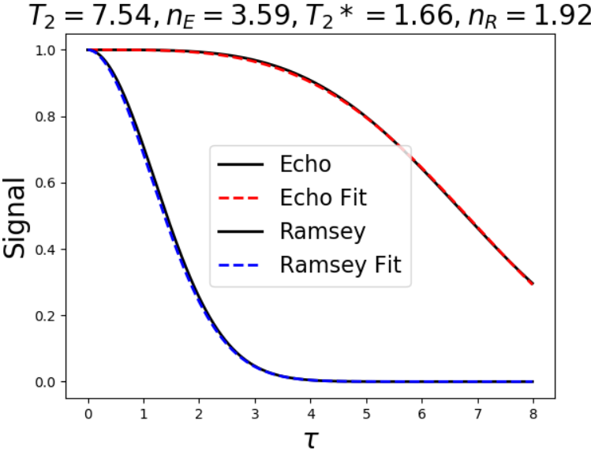
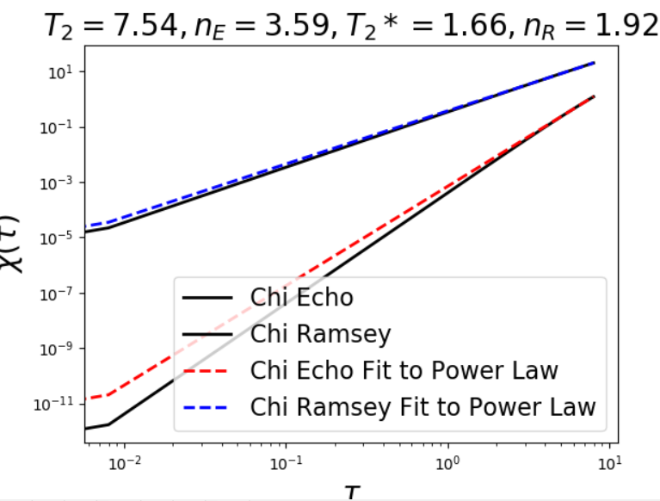
Occupation Probability = 0.1 sample dataset
NV
Spin up
Spin down

Slide 8
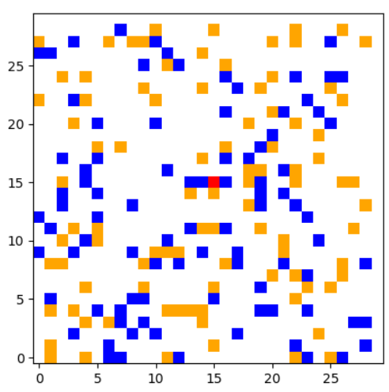
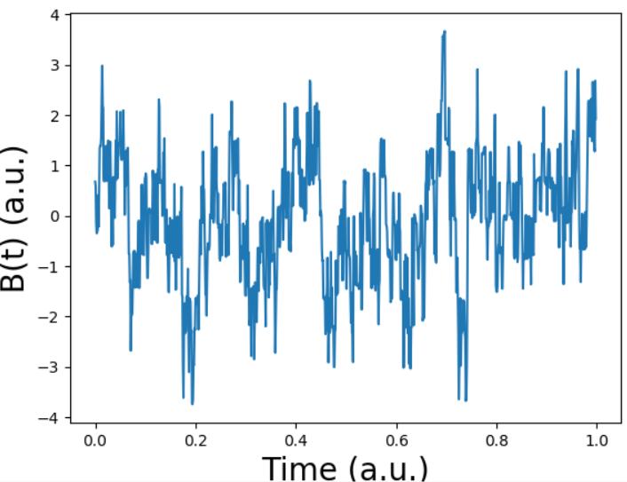
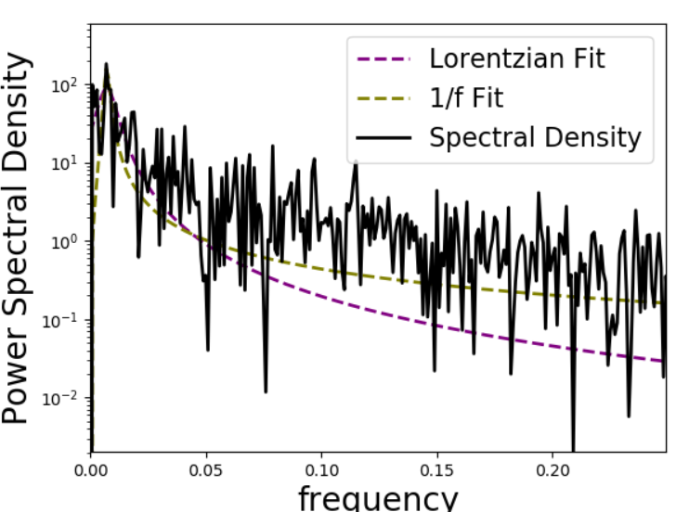
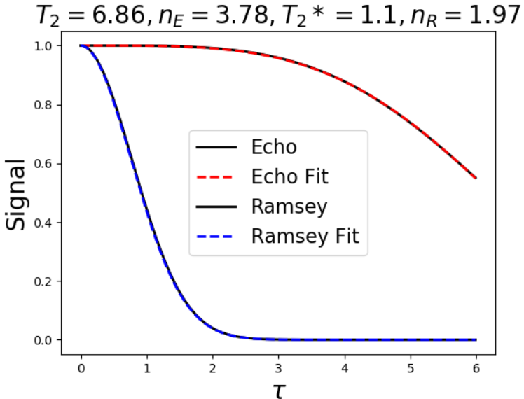
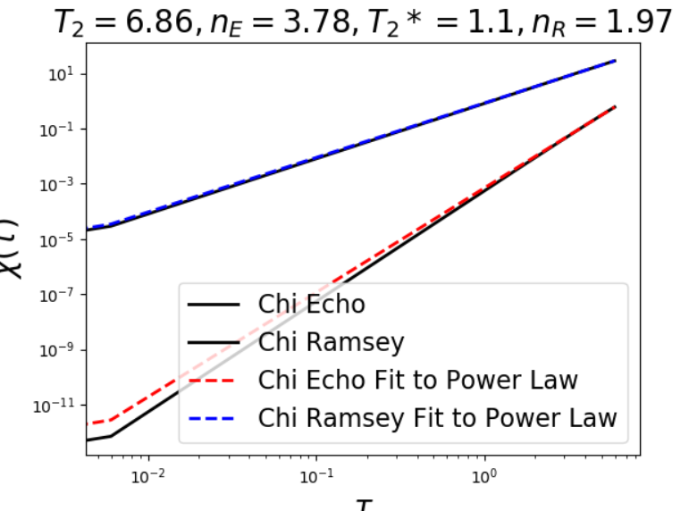
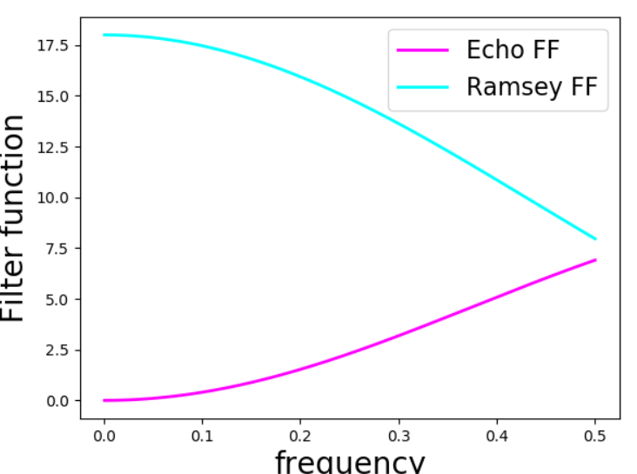
Occupation Probability = 0.2 sample dataset
NV
Spin up
Spin down

Slide 9
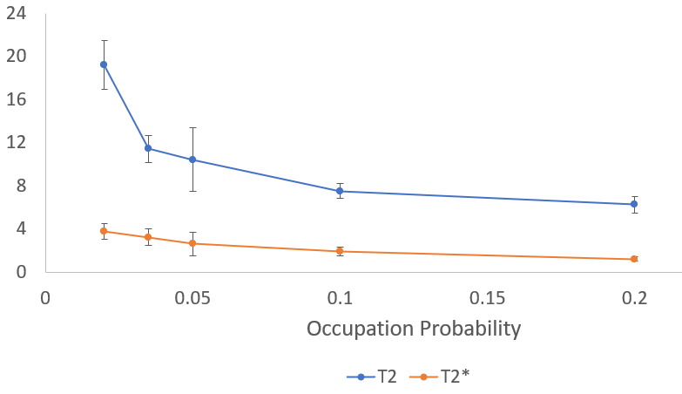
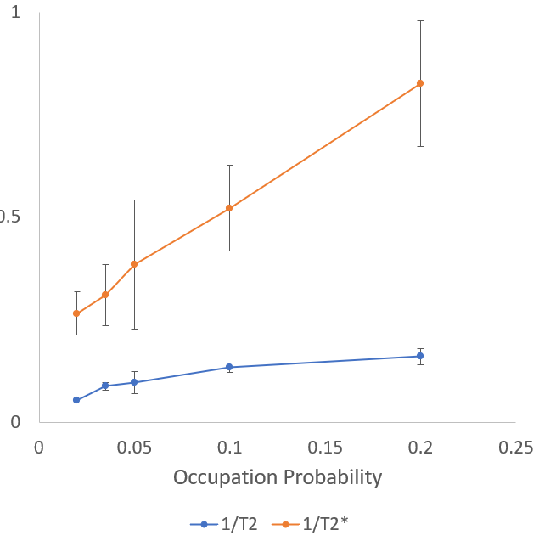
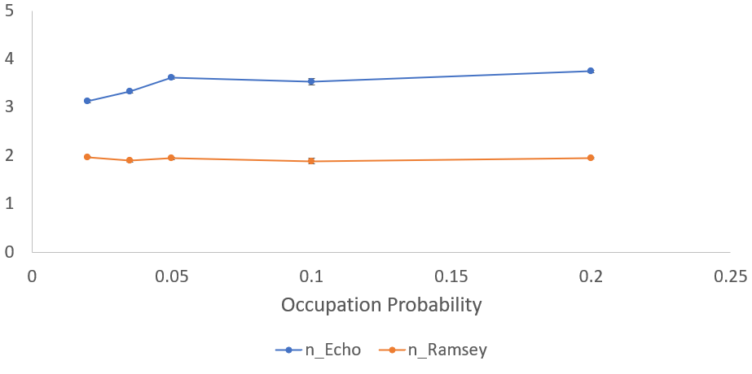
Results after 5 iterations at each occupation probability
Decay time
1/Decay time
Stretch parameter

Slide 10
Notes
Python did not seem to always give the best fit to the stretch parameter.
Log-log plots are included to easily see where it was underestimated
Fitting only early time tended to give better fits
Flip-flop probability per time step is given by F₀/r³ where F₀ is a constant (0 < F₀ < 1) and r is the distance between the two spins (r > 1)
r dependence is justified because the flip-flop terms come from dipolar couplings
All calculations are dimensionless. There are no factors of hbar, gamma, etc. in the code. Only looking that the functional forms of the spectral density and sequence decay, which shouldn’t depend on units.
Easily adjustable parameters include occupation probability, flip-flop probability, lattice size, spins in the bath (spin 1/2, 1, etc.) and tau_final

Slide 11
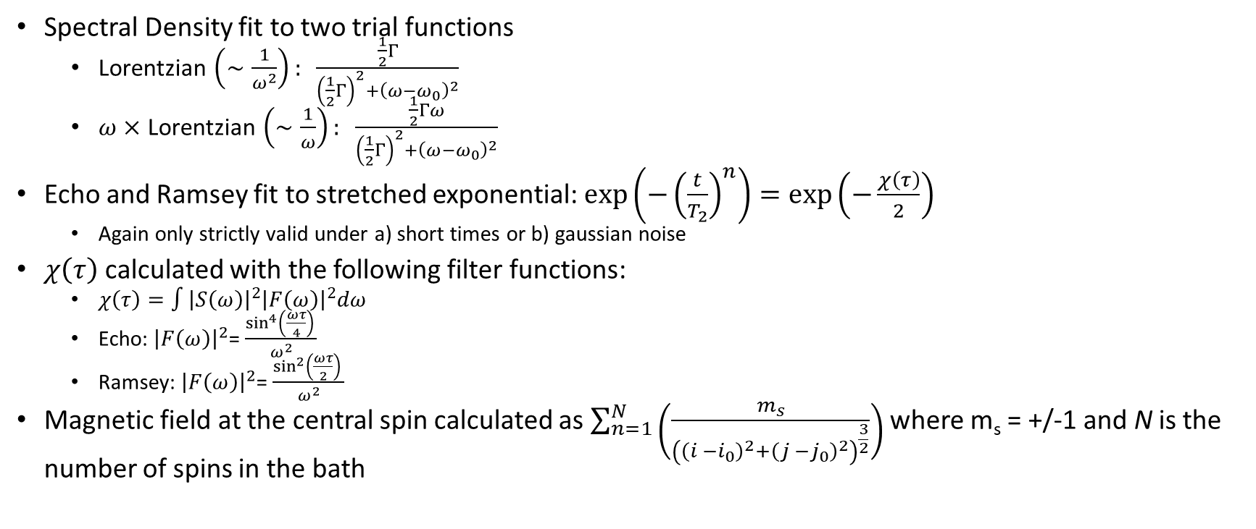
Fitting functions:
Spectral Density fit to two trial functions
Lorentzian $\left(∼\frac{1}{ω^{2}}\right): \frac{\frac{1}{2}Γ}{{\left(\frac{1}{2}Γ\right)}^{2}+{\left(ω−ω_{0}\right)}^{2}}$
$ω×$Lorentzian $\left(∼\frac{1}{ω}\right): \frac{\frac{1}{2}Γω}{{\left(\frac{1}{2}Γ\right)}^{2}+{\left(ω−ω_{0}\right)}^{2}}$
Echo and Ramsey fit to stretched exponential: $exp\left(−{\left(\frac{t}{T_{2}}\right)}^{n}\right)=exp\left(−\frac{χ\left(τ\right)}{2}\right)$
Again only strictly valid under a) short times or b) gaussian noise
$χ\left(τ\right)$calculated with the following filter functions:
$χ\left(τ\right)=∫{\left|S\left(ω\right)\right|}^{2}{\left|F\left(ω\right)\right|}^{2}dω$
Echo: ${\left|F\left(ω\right)\right|}^{2}$= $\frac{\sin^{4}\left(\frac{ωτ}{4}\right) }{ω^{2}}$
Ramsey: ${\left|F\left(ω\right)\right|}^{2}$= $\frac{\sin^{2}\left(\frac{ωτ}{2}\right) }{ω^{2}}$
Magnetic field at the central spin calculated as $\sum_{n=1}^{N}{\left(\frac{m_{s}}{{\left({\left(i −i_{0}\right)}^{2}+{\left(j −j_{0}\right)}^{2}\right)}^{\frac{3}{2}}}\right)}$ where m_{s} = +/-1 and N is the number of spins in the bath

Slide 12
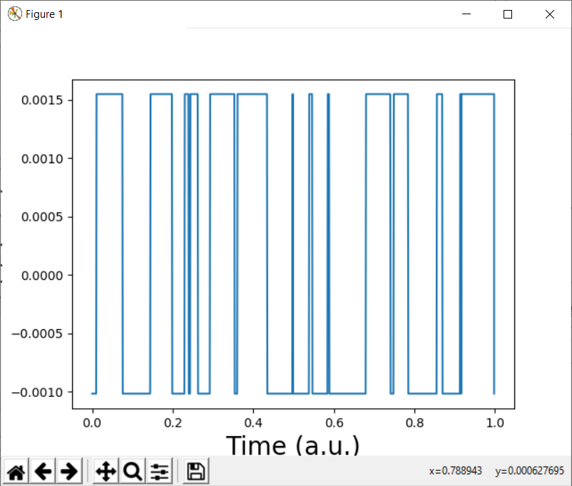
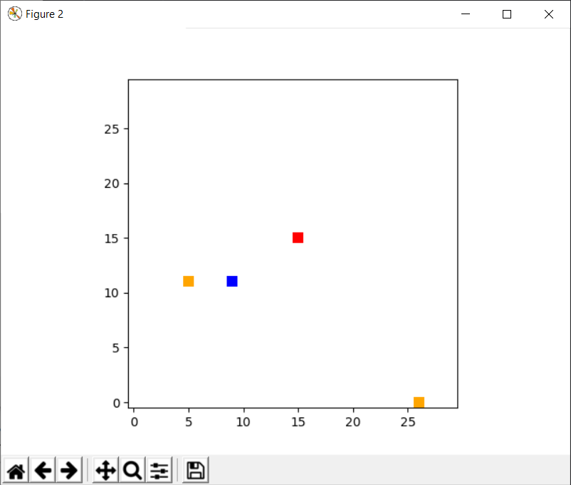
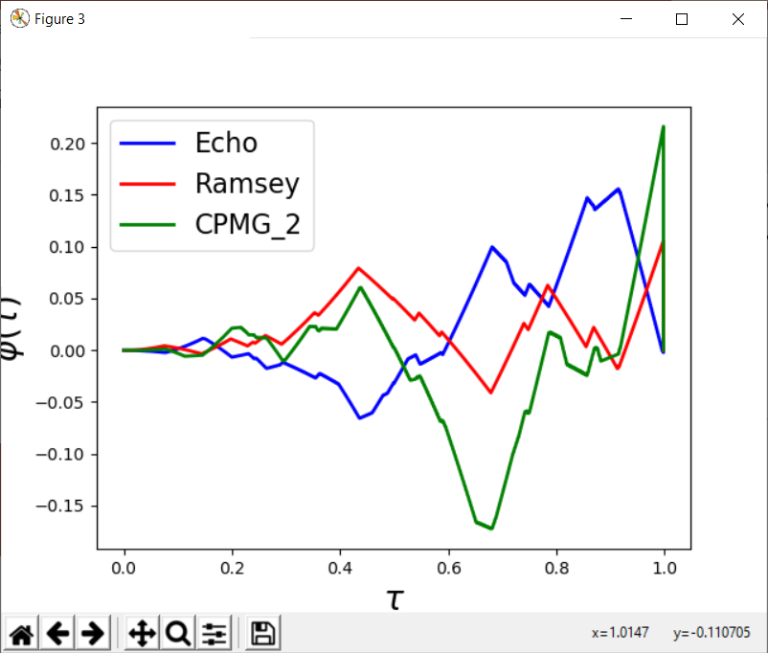
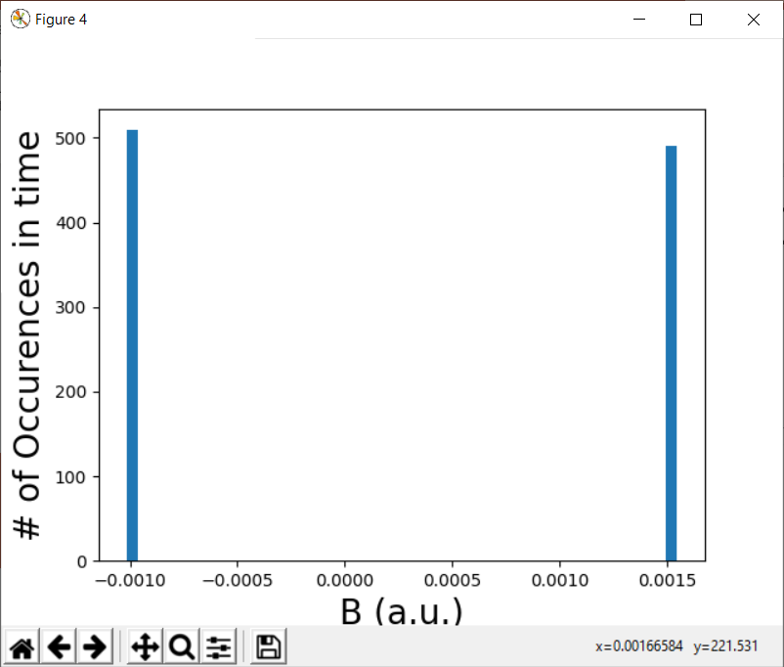
Occ. Prob. 0.01, showing details of B and phi
B(t) at NV
Lattice
Orange = spin up
Blue = spin down
Red = NV
Phase accumulation for various pulse sequence
Histogram of B

Slide 13
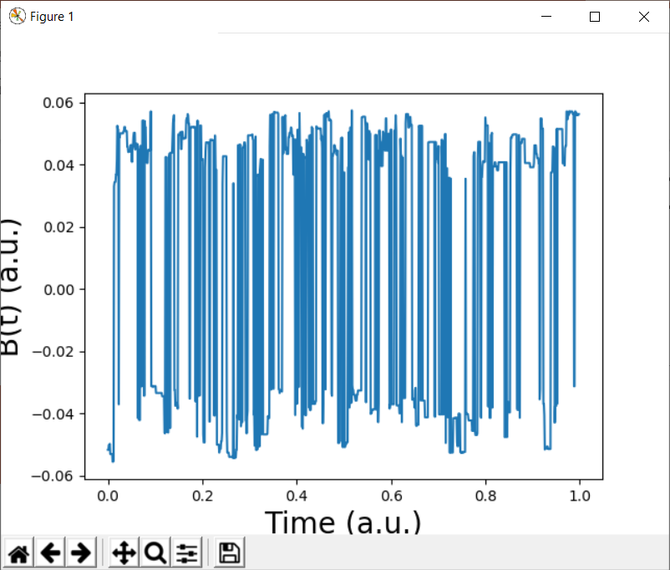
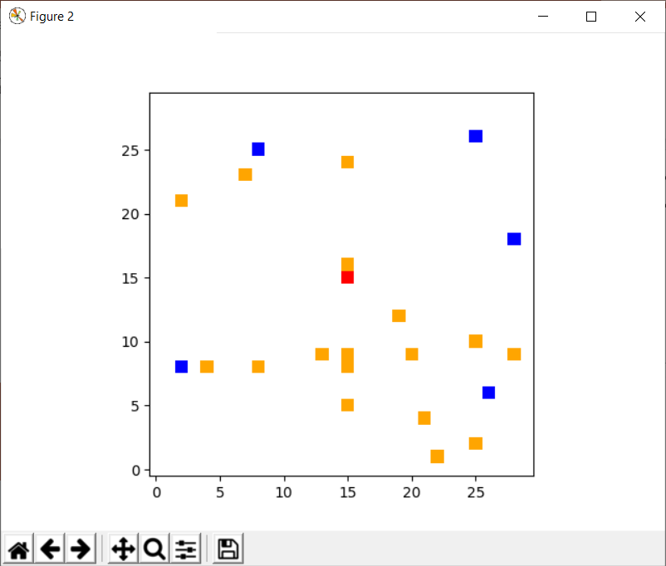
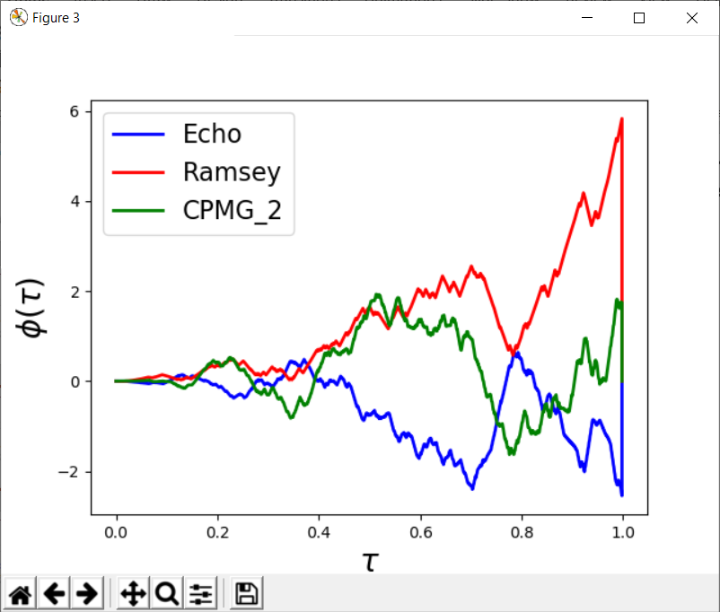
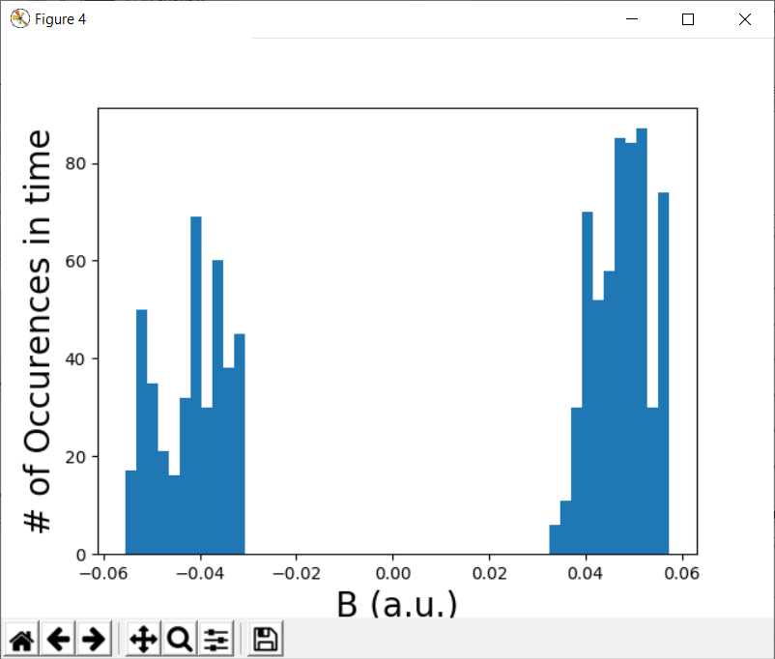
Occ. Prob. 0.02

Slide 14
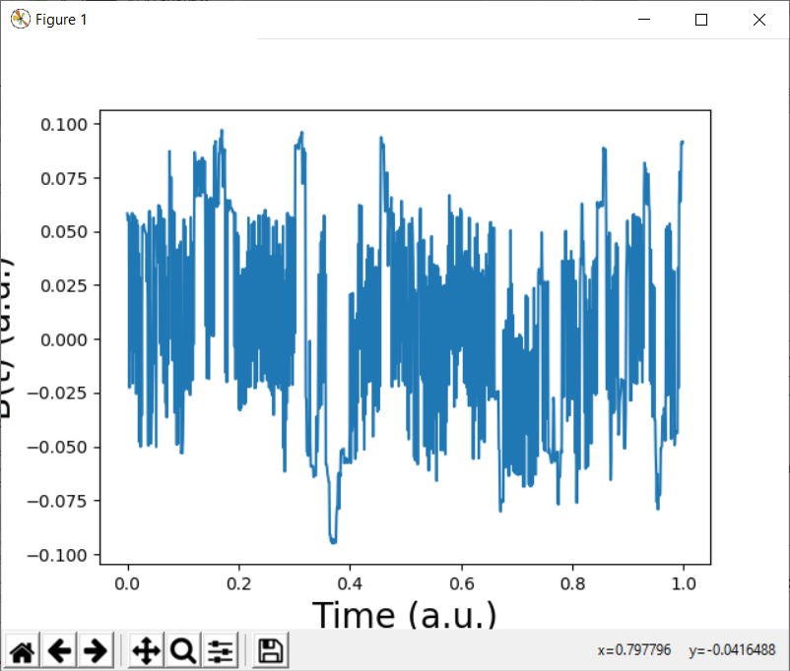
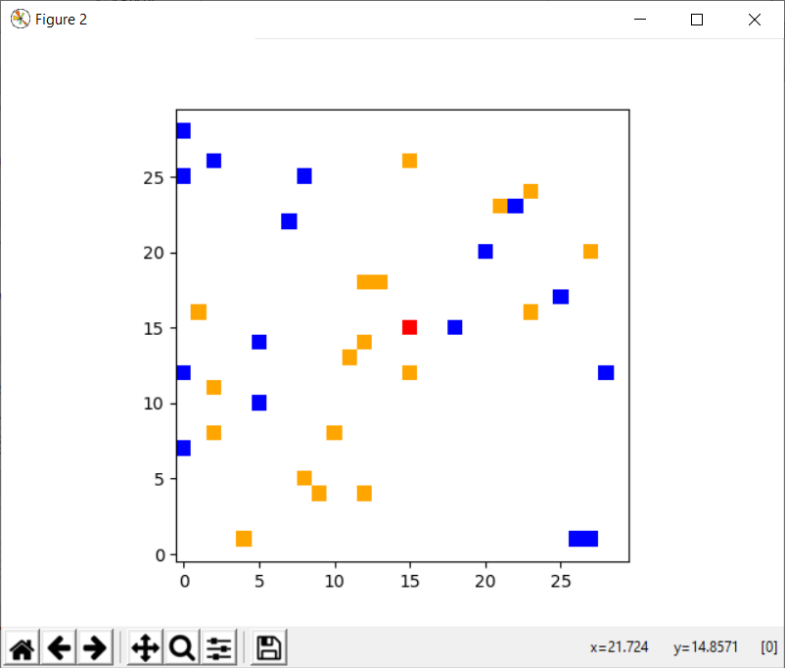
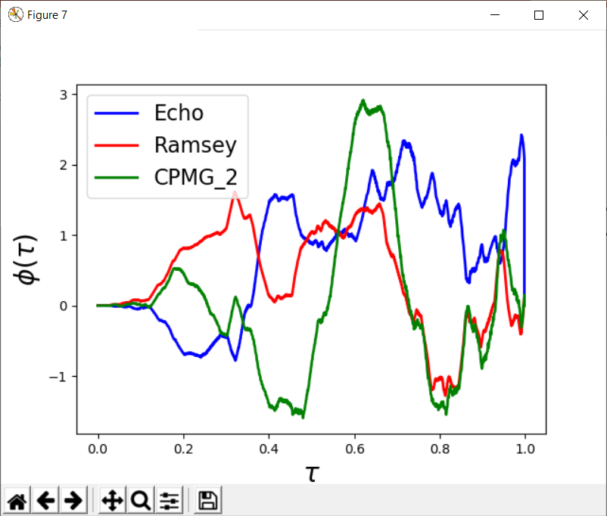

Occ. Prob. 0.05

Slide 15




Occ. Prob. 0.1

Slide 16




Occ. Prob. 0.2

Slide 17




Occ. Prob. 0.3

Slide 18

Decay calculated from taking <cos(phi)>, fit to stretched exponential

Slide 19

Other possibilities
Simulate a bath dominated by T1 relaxation with a random matrix
E.g. say spin up is +1, down is -1, then represent the lattice (here 3x3) by something like
$$L=\left( \begin{matrix}+1 & 0 & −1 \\ −1 & 0 & 0 \\ 0 & +1 & 0\end{matrix}\right)$$
Define a diagonal matrix with entries either +1 (no flip) or -1 (flip)
$$F_{1}=\left( \begin{matrix}+1 & 0 & 0 \\ 0 & −1 & 0 \\ 0 & 0 & +1\end{matrix}\right);F_{2}=\left( \begin{matrix}+1 & 0 & 0 \\ 0 & +1 & 0 \\ 0 & 0 & −1\end{matrix}\right)$$
Repeatedly multiply the lattice by a new random matrix to simulate spin flips
$$L_{new}=F_{1}L_{old}F_{2}$$
To get an idea for what percentage of the entries should be -1, use that the spin flips should tend to equilibrate the lattice temperature with the spin temperature

